Slide 1
DIJKSTRA
Path Planning Algorithm
Blanchon marc - Ahuja mohit
University of Burgundy - le Creusot

Slide 2
Summary
Path planning algorithm - dijkstra
General Presentation
Shortest Path Problem / Traveler Salesman Problem
The Principle
Theory
In our field
One Robot vs Two Robots
Conclusion

Slide 3
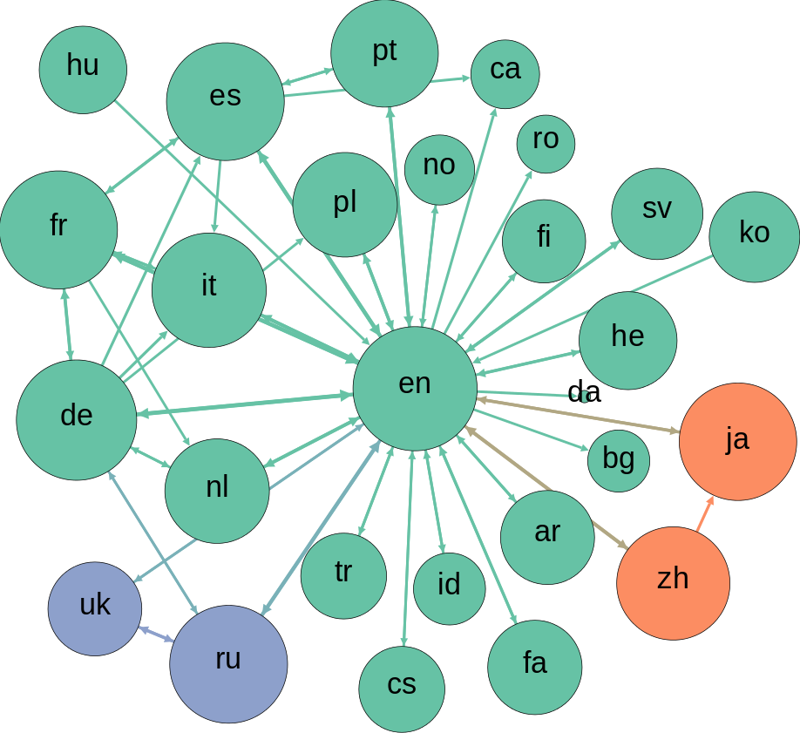
General presentation
Path planning algorithm - dijkstra
Algorithm created by Edsger Dijkstra and published in 1959
Solving Shortest path in Graph Theory
Applicable on many problems such as path planing of a robot interpreted as a Traveler Salesman
Used and studied a lot in many topics
Graph of wikipedia editors / languages

Slide 4
Shortest path problem
Path planning algorithm - dijkstra
From a point A to a point B passing by nodes and going as fast as possible
Using multiple data, commonly weight between two nodes in a graph as generic data types and extending to distances or computation complexities
Many possible extension of this problem, robot passing through checkpoints, traveler passing through town or more complex, from an input to a result choosing the best computation cost of function to be optimised

Slide 5
Traveler Salesman problem
Path planning algorithm - dijkstra
From a point A to a point B passing by towns and going as fast as possible
Near the robot actions as said before, robot can be interpreted as salesman but instead of two we can create checkpoints
Creating the node propagation to loop from A to B, pass by all nodes and come back to A
Can be used for GPS computation

Slide 6
the principle
Path planning algorithm - dijkstra
Taking any graphs with weight between nodes
Create a sub-graph with the minimal distance between the node and the source nod ( A )
First consider all nodes as infinite weight and the source ( A ) as 0
Then propagate by choosing a node that has a minimal travel weight and compute neighbourhood
Always compute the minimal distance from the source node and the new node ( for every iteration checking if going back is smaller )
Propagate till we reach the end point ( B )

Slide 7
Theory
Path planning algorithm - dijkstra
We can already see the polynomial complexity
O ( | E | + | V | log | V | ) where E is #edges and V #vertices
The bigger the graph the bigger computation cost
Still the best algorithm for shortest path ( or one of them for special cases and not taking account Specialized variant )

Slide 8
Theory
Path planning algorithm - dijkstra
Greedy Algorithm
Taking without exception all nodes one by one and recompute everything step by step
Can be stuck in very long computation time ( lot of nodes )
Dependent of the machine that is running the code ( in our case a robot )
Dependent of the coding and can be more efficient using some languages ( libraries, language specification, machine optimisation )

Slide 9
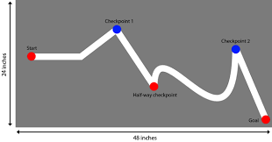
in our field - Single robot
Path planning algorithm - dijkstra
Considering a single robot, this can be time consuming. We need to instantiate a graph or checkpoints with distances in order to perform the algorithm.
It require a lot of pre-work if we only use this approach
We are able to avoid obstacles till we initiate the checkpoints, this is just the user that have to do correct paths
Reduce the work on the robot, or the application but load the user. Still the algorithm can be heavy.

Slide 10
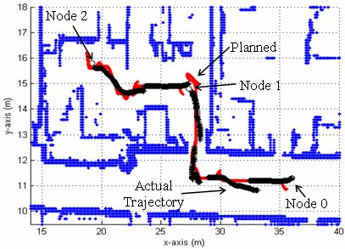
in our field - two robots
Path planning algorithm - dijkstra
The Grapher
One robot will be used to create a map, avoid obstacles and without considering the time optimisation.
This robot will be avoid obstacles and crate checkpoint at each end of obstacles.
The more the robot take information, the best it is. The usage is just to calculate distances between points using simple maths and trigonometry.
Reduce the pre-work, no human action.

Slide 11
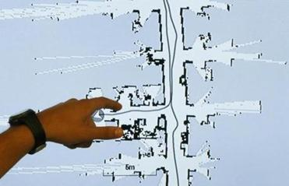
in our field - two robots
Path planning algorithm - dijkstra
The Runner
Accept as input the set of nodes and weight of the Grapher.
Compute the Dijkstra algorithm and the shortest path
Automatically avoid obstacles, only require the computation of path planing, moving straight and rotating

Slide 12
One Robot
Path planning algorithm - dijkstra
TWO Robot
Heavy for the user but the runner robot is still not overloaded
Possibility of improvement by computing the path planning independently of the robot
Dependant on the graph to avoid obstacle and precision of measures
Easily simulated, more difficult to apply in real world
No pre-work for the user
Two robots with simple applications, creating graph or following graph
Possibility of improvement by computing the path planning independently of the robot
Require two robots but is very efficient
Dependent of the AI of the first robot.

Slide 13
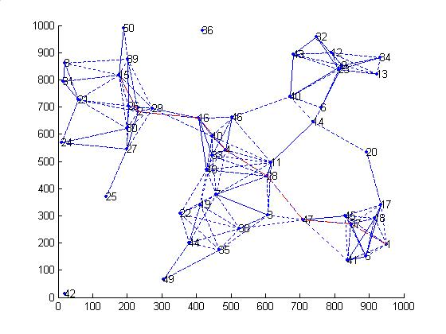
Conclusion
Path planning algorithm - dijkstra
Dijkstra Algorithm has multi usages and can be applied on lot of human problems
Efficient path planner but rely on the coder and the efficiency of the mapping ( human or robot AI )
Can be extended to multiple subjects and used in many fields ( data analysis, path planing, GPS prevision and adaptation, TSP …)
A smart way of using the graphs and the checkpoints for a robot
Till we can use two independent robots with AI’s the software is very independent

